Slide 1
Circular Link List

Slide 2
Defination
linked list where all nodes are connected to form a circle.
There is no NULL at the end.
A circular linked list can be a singly circular linked list or doubly circular linked list.

Slide 3


Operation
Check if a linked list is Circular Linked List
An empty linked list is considered as circular.
Convert singly linked list into circular linked list
Traversal
Insertion
Deletion

Slide 4
Exchange first and last nodes in Circular Linked List
The task should be done with only one extra node, you can not declare more than one extra node and also you are not allowed to declare any other temporary variable.
Note: Extra node means need of a node to traverse a list.
Examples:
Input : 5 4 3 2 1
Output : 1 4 3 2 5
Input : 6 1 2 3 4 5 6 7 8 9
Output : 9 1 2 3 4 5 6 7 8 6

Slide 5
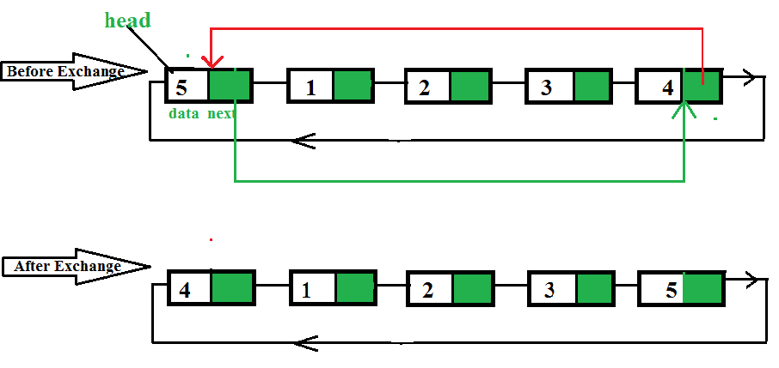
Link management

Slide 6
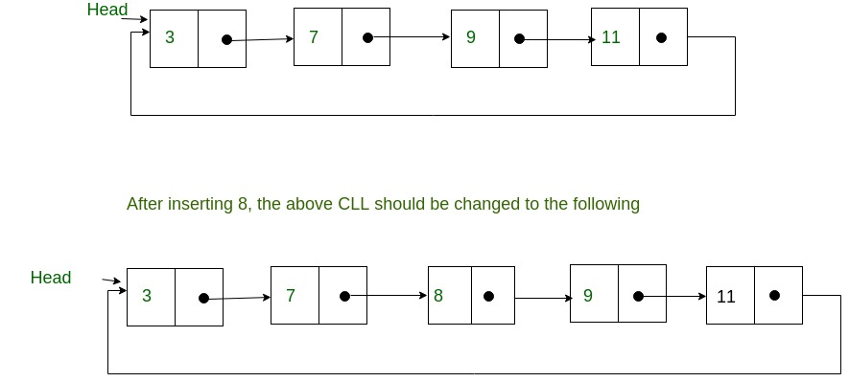
Sorted Insertion
Extended Problem Statement: Insertion in a sorted circular linked list when a random pointer is given

Slide 7
Reference for Algorithms
http://www.btechsmartclass.com/data_structures/circular-linked-list.html

Slide 8
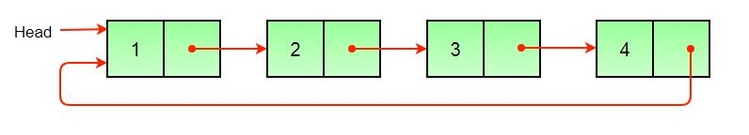
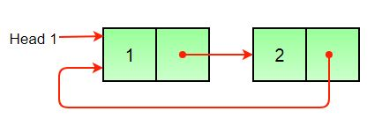
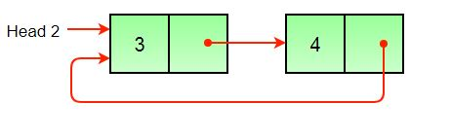
Split a Circular Linked List into two halves
Store the mid and last pointers of the circular linked list
Make the second half circular.
Make the first half circular.
Set head (or start) pointers of the two linked lists.

Slide 9
Hare and Tortoise problem to find cycle (Self study)
https://medium.com/@tuvo1106/the-tortoise-and-the-hare-floyds-algorithm-87badf5f7d41

